Slide 1

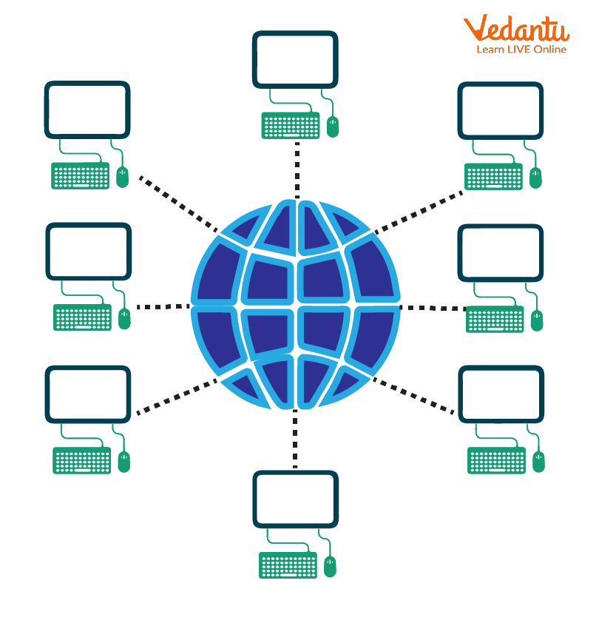


NETWORK DENIAL OF SERVICE DETECTION
Guide: Dr. Sheela Jayachandran

Slide 2

Abstract
As IoT-enabled devices and mobile technology improvements became more common in our everyday lives, significant increases in wireless network traffic resulted in the generation of a large volume of high-dimensional network log data. Because of this, there are challenges facing the security of Wi-Fi network systems that must analyze such complex, large amounts of data for intrusion detection. Many Wi-Fi network systems employ machine learning-based intrusion detection systems (IDS)
In order to improve prediction accuracy, we propose an unsupervised approach in this study that replaces human intervention and the manual labeling process with an automatic feature extraction and selection process.
The NSL-KDD Dataset, which was recently gathered and includes actual evidence of several network attack types, is used in this study.
The results of the trial showed how effective our feature extraction and selection strategy was evaluating and comparing the performance of the selected characteristics and the accuracy of the intrusion detection of the three distinct assault techniques.

Slide 3
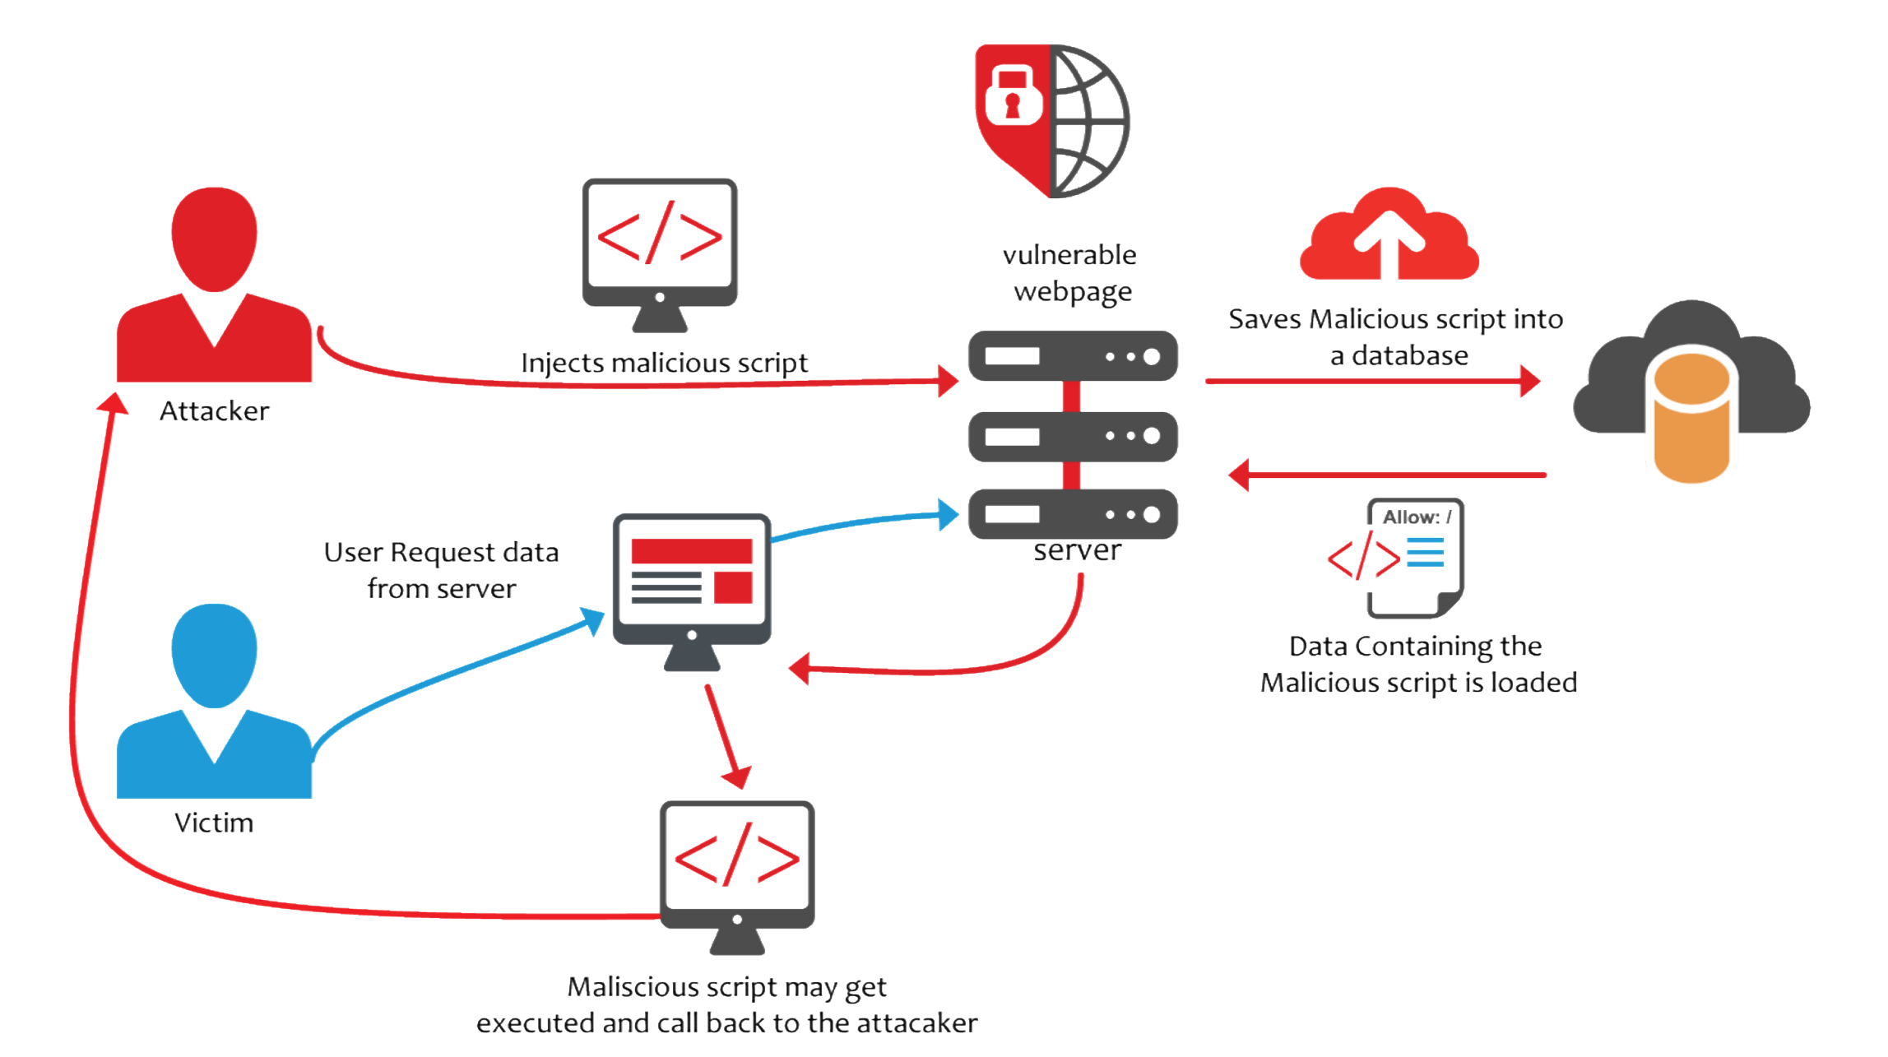
Introduction
The increased usage of wireless networks, driven by IoT devices and advanced mobile technologies, has led to a significant surge in wireless traffic. This heightened usage has also resulted in a rise in both active and passive attacks on wireless network systems, posing privacy and security challenges. Kollias et al categorized intrusion attacks on WEP (wired equivalent protection) into three groups:
Injection Attacks
Flooding Attacks
Impersonation Attacks

Slide 4
Introduction
IDSs are categorized into three categories based on the detection algorithms they utilize to find intrusions and attacks: rule-based, signature-based, and anomaly detection-based. In order to characterize common behaviors, the rule-based IDS manually compiles a set of rules and constraints.
Injection Attacks : These attacks flood the network with validly encrypted data frames of smaller size. It's worth noting that injection attacks are a significant security risk, including SQL injections, which were identified as the third most serious web application security risk in 2021. To protect against SQL injection attacks, it is crucial to understand their impact and how they occur, follow best practices, test for vulnerabilities, and invest in software that actively prevents such attacks.
Flooding Attacks: Flooding attacks create a sudden increase in the number of management frames transmitted per time unit.
Impersonation Attacks : Impersonation attacks involve introducing an additional access point (AP) in the network's vicinity, broadcasting Beacon frames that advertise a valid preexisting network.

Slide 5
Objective
Numerous Wi-Fi network systems include machine learning-based IDs, which mostly need human oversight throughout the feature extraction, selection, and labeling stages of training data preparation for classification. Our goal is to replace human supervision with an unsupervised method that uses an automated feature extraction and selection procedure.
Background and Literature Survey
To detect the kind of impersonation assault, a weighted feature selection approach was created in conjunction with a classifier artificial neural network (ANN) and automatically extracted and selected features. This was necessary to minimize the dimensionality of huge data.
Feature Selection
We employee four feature selection methods, each of which is a well-known supervised machine learning classifier with an ability to builds a model by the weight of each feature, which is used to select features.

Slide 6

Working Methodology
Proposed System
Building many models, comparing their accuracy with the NSL-KDD dataset, determining if deep learning can be implemented, and determining which model is suitable for the Intrusion Detection System comprise the next project.
Feature Extraction
To extract features, we use a stacked auto encoder approach based on neural networks. An unsupervised neural network model called an auto encoder uses backpropagation to adjust the target values to equal the inputs.
Feature Selection
We employee four feature selection methods, each of which is a well-known supervised machine learning classifier with an ability to builds a model by the weight of each feature, which is used to select features.

Slide 7
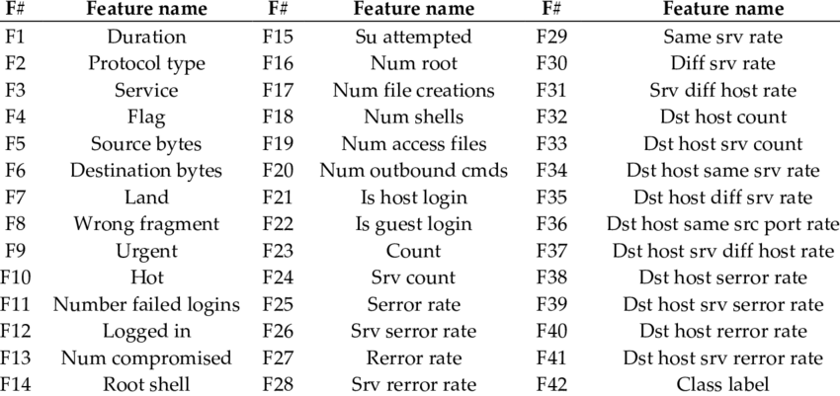
Data Set
NSL-KDD DATASET
The KDD'99 data set has been updated with the NSL-KDD data set. An efficient benchmark data set for comparing various intrusion detection techniques is available to researchers. The NSL-KDD train and test sets have a respectable amount of records. This benefit eliminates the requirement to choose a small sample at random and makes it feasible to conduct the tests on the entire set at a reasonable cost.
KDDTrain+.ARFF
KDDTrain+.TXT
KDDTrain+_20Percent.ARFF
KDDTrain+_20Percent.TXT
KDDTest+.ARFF
KDDTest+.TXT
KDDTest-21.ARFF
KDDTest-21.TXT
NSL-KDD dataset features

Slide 8
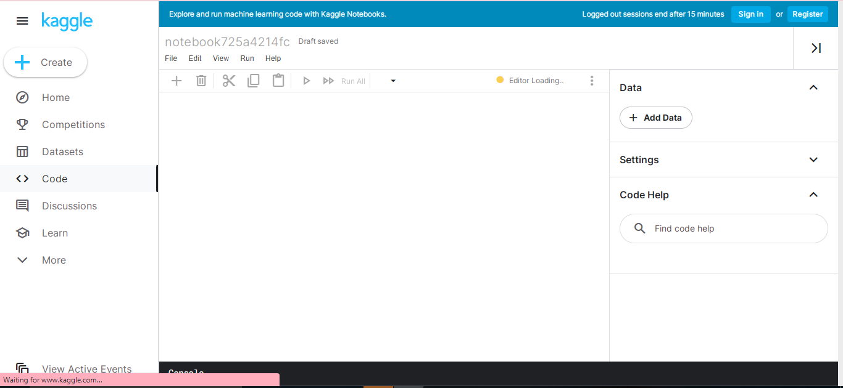
Software Details
Kaggle
For those interested in machine learning and data science, Kaggle is an online community platform. Users may use GPU integrated notebooks, search and publish datasets, communicate with other users, and compete with other data scientists to solve data science challenges on Kaggle.

Slide 9

Software Details
GitHub
GitHub is a site that hosts code for version control and teamwork. It enables remote collaboration on projects between you and other people. You will learn the fundamentals of GitHub, including repositories, branches, commits, and pull requests, in this lesson.

Slide 10

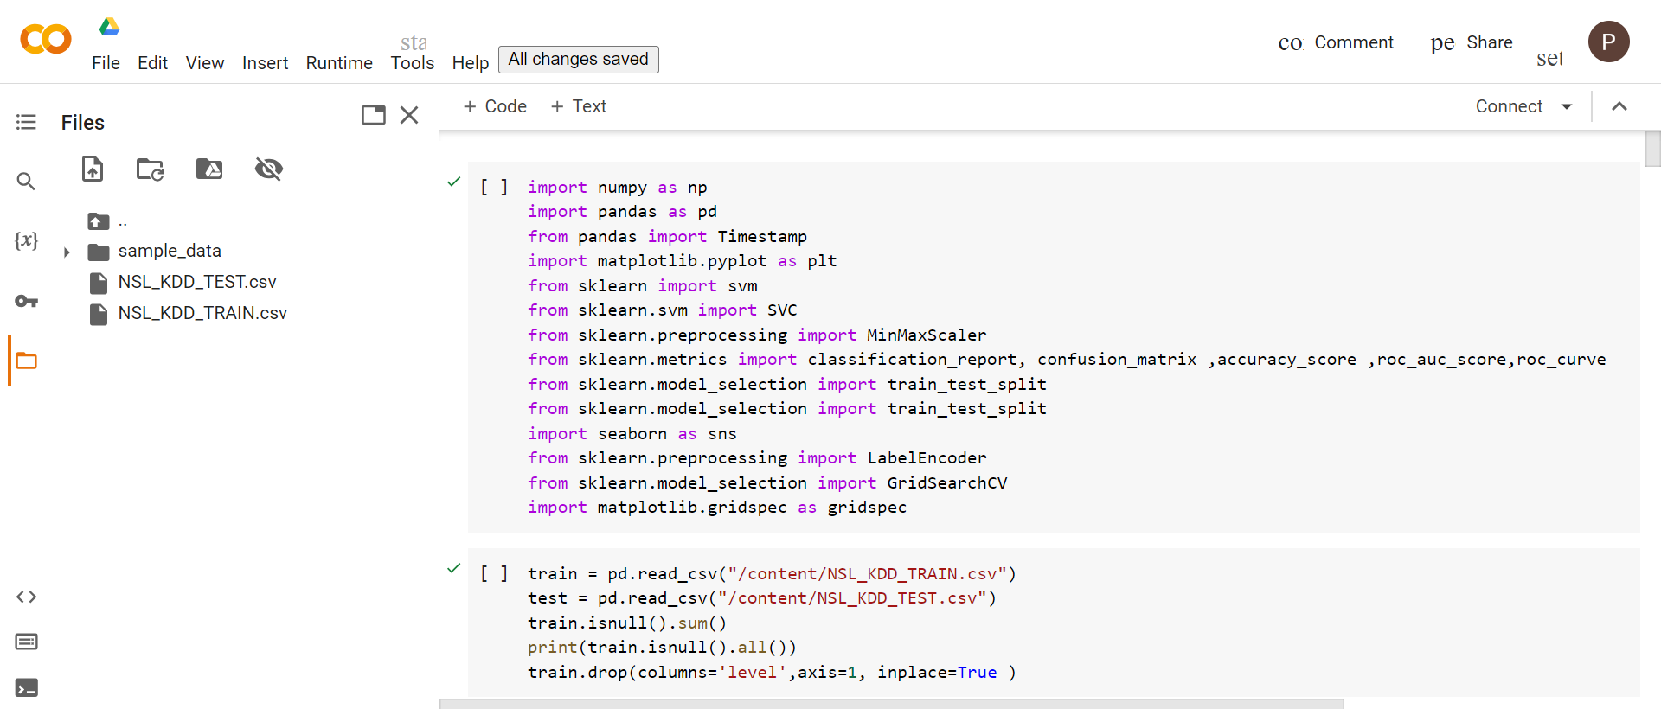
Software Details
Colab
With Colab, anybody can create and run any Python code through a browser, making it particularly useful for data analysis, machine learning, and teaching.

Slide 11
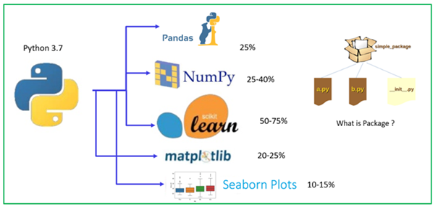
Libraries Used
Libraries used are Numpy Pandas,Matplotlib,Sklearn,seaborn,Tenserflow etc for all the models

Slide 12
Logistic Regression
SVM
Supervised Models

Slide 13
Logistic Regression
Logistic regression is a statistical method used to predict the probability of a binary outcome, such as yes or no, pass or fail, or spam or not spam. It is a supervised learning algorithm, meaning that it learns from a training set of data that contains both the input variables and the corresponding output labels. The algorithm then uses this training data to fit a logistic regression model, which can be used to predict the probability of the binary outcome for new input data.
Logistic regression is a popular choice for classification tasks because it is relatively simple to understand and implement, and it can be very effective for predicting binary outcomes. It is also relatively robust to outliers and missing data.
Advantages of Logistic Regression
Easy to understand and implement: The logistic regression model is relatively easy to understand and implement, making it a good choice for beginners.
Effective for binary classification: Logistic regression is a very effective algorithm for predicting binary outcomes, and it can outperform other classification algorithms in many cases.
Robust to outliers and missing data: Logistic regression is relatively robust to outliers and missing data, making it a good choice for real-world data sets.

Slide 14
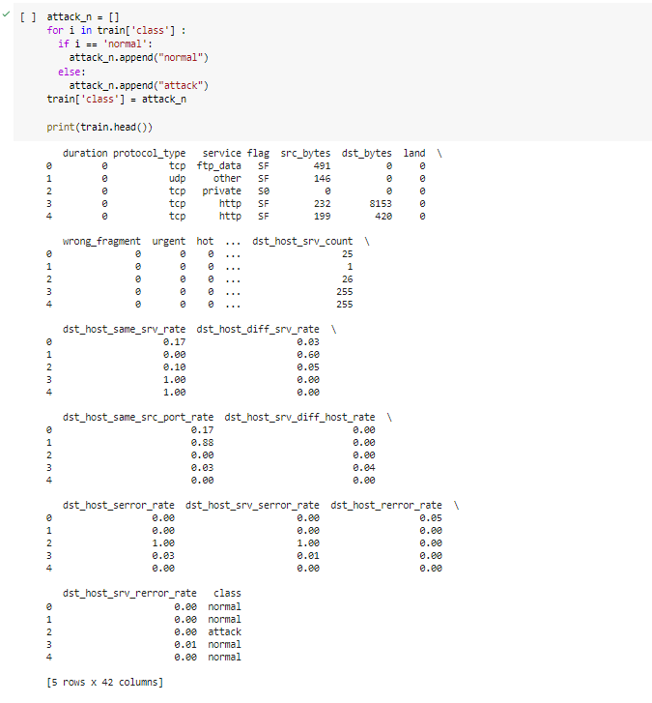
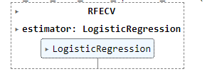
Logistic Regression

Slide 15
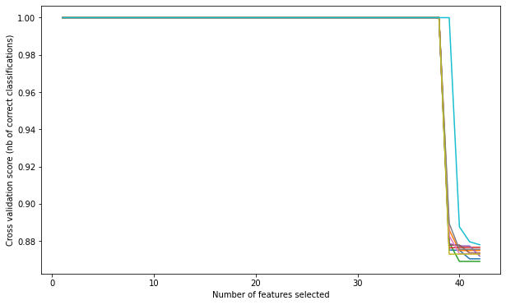
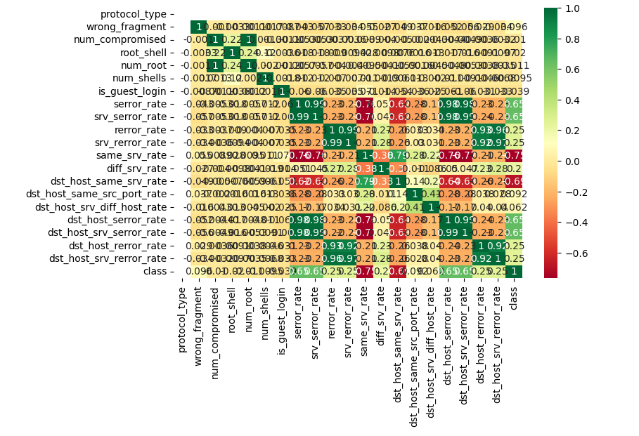
Logistic Regression
Plot of features and relation
Corelation plot

Slide 16
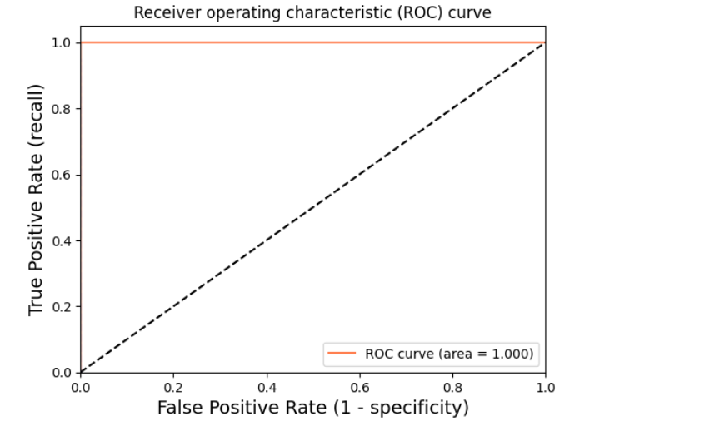
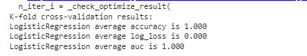
Logistic Regression
True positive Vs False Positive Plot
Result of Logistic Regression

Slide 17
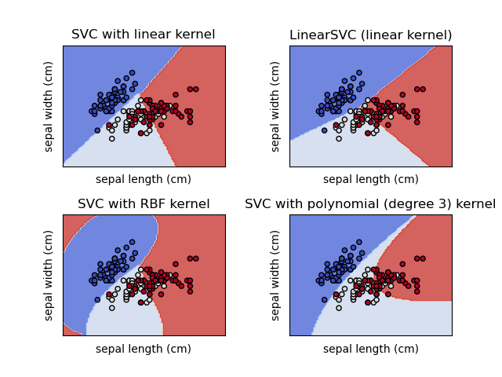
SVM
Support Vector Machine (SVM) is a supervised machine learning technique that is applied to regression and classification. We also use the word "regression concerns," although "categorization" is more suitable. The SVM approach aims to find a hyperplane in an N-dimensional space that unambiguously classifies the data points.
The size of the hyperplane is determined by the number of features. When input characteristics are limited to two, the hyperplane can be thought of as a line. If three input characteristics are present, the hyperplane transforms into a 2-D plane.
It becomes difficult to imagine something having more than three characteristics.
Different kernel functions can be specified for the decision functions and its possible to specify custom kernels

Slide 18
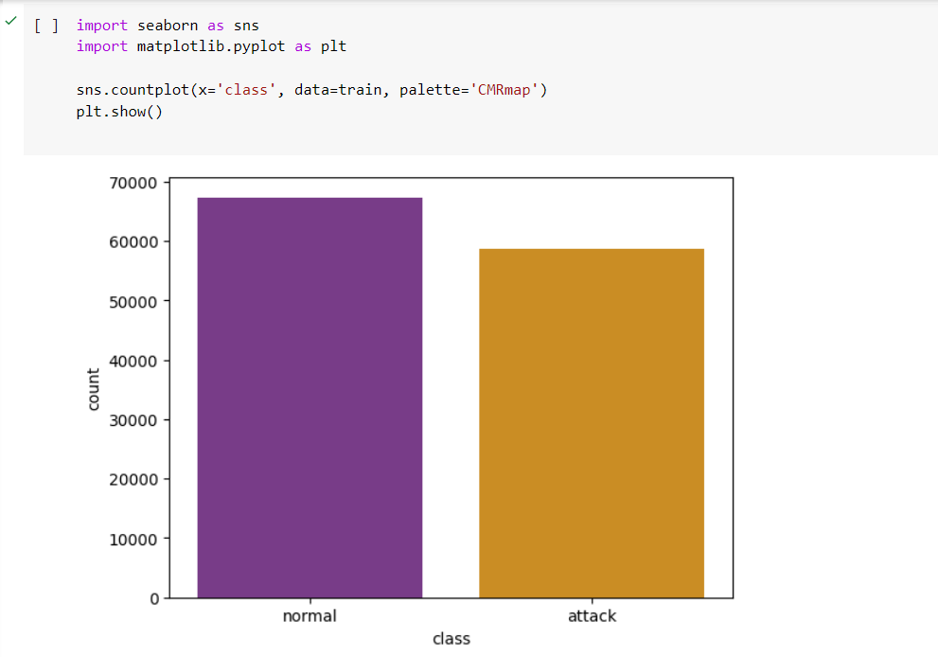
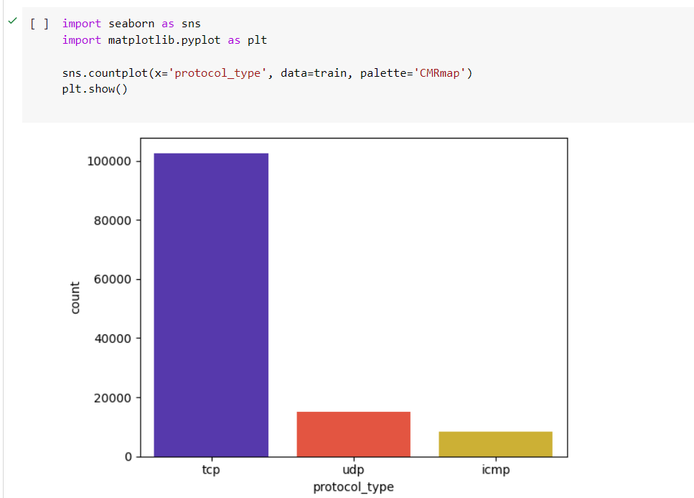
SVM
Plot of attacks column
Plot of protocol type columns

Slide 19
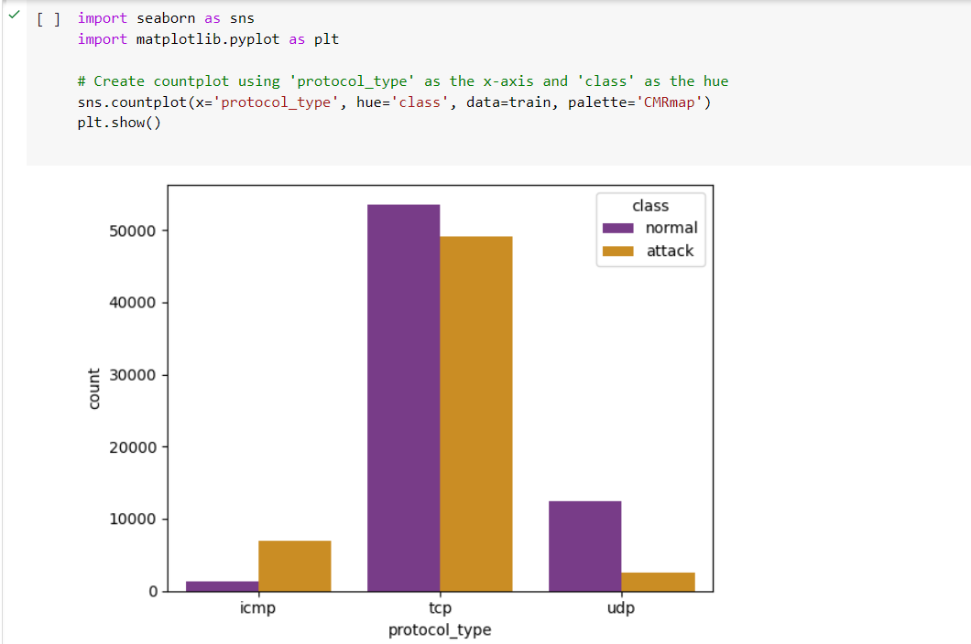
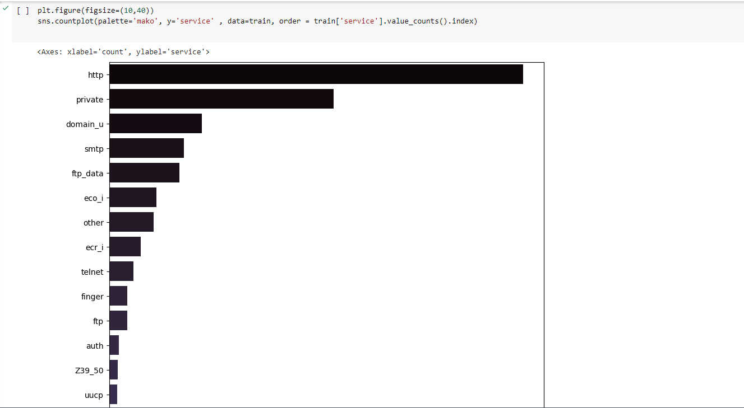
SVM
Plot between attack and protocol_type columns
Plot of service column

Slide 20
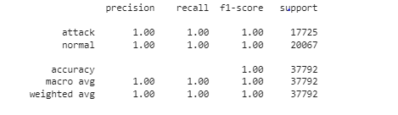
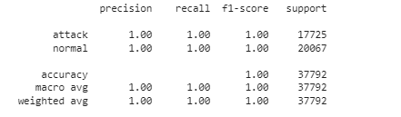
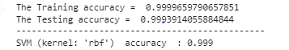
SVM
Liner SVC Accuracy
Liner SVC Result

Slide 21
K - Means
Hierarchical
Un- Supervised Models

Slide 22
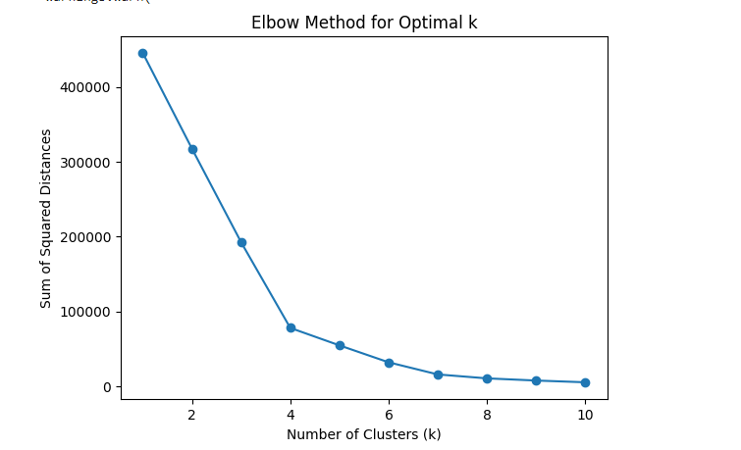
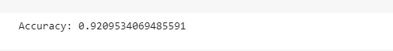
K - Means
K-means clustering is a popular unsupervised machine learning algorithm that partitions a set of data points into K clusters. It is an iterative algorithm that aims to minimize the within-cluster variance, assigning data points to the cluster with the nearest mean (centroid).
Advantages of K- Means
Simple and easy to understand: K-means clustering is a relatively simple algorithm that is easy to implement and understand.
Efficient: K-means clustering is an efficient algorithm that can be applied to large datasets.
Versatile: K-means clustering can be used for a variety of applications, including customer segmentation, image segmentation, and anomaly detection.

Slide 23
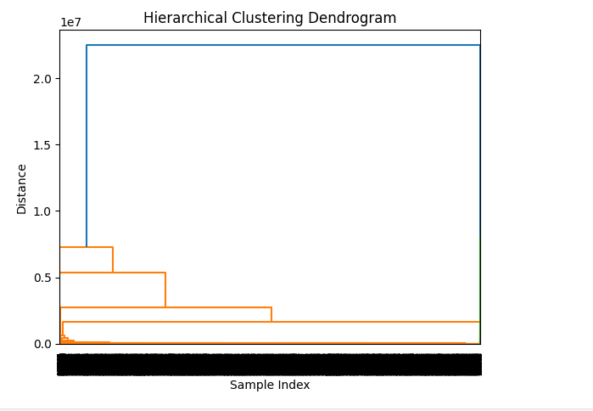
Hierarchical Algorithm
Hierarchical clustering, also known as hierarchical cluster analysis or HCA, is a type of unsupervised machine learning algorithm that groups a set of data points into a hierarchy of clusters. It is an iterative algorithm that builds a dendrogram
Advantages of Hierarchical Algorithm
No need to specify the number of clusters: Hierarchical clustering does not require the number of clusters to be specified in advance. This is a major advantage over other clustering algorithms, such as K-means clustering.
Can handle outliers: Hierarchical clustering is more robust to outliers than other clustering algorithms.
Can reveal hierarchical relationships: Hierarchical clustering can reveal hierarchical relationships between the clusters in the data.

Slide 24

CONCLUSION AND FUTURE WORK
Following the analysis's conclusion, we identified the critical frequencies and tested them; we obtained an accuracy of 1 and no false positives. SVM kernels with RBF, Polynomial, and Linear outcomes have a value of 1.
We obtained 0.99 accuracy using logistic regression.
Accuracy of unsupervised algorithm for K-means is 0.92 and for Hierarchical is 0.75
Future Works
The future works for network denial of service (DDoS) detection are likely to be more sophisticated and efficient. These systems will be able to detect and prevent DDoS attacks more effectively in real time, and they will be more resilient to new and emerging attack techniques.
Machine learning and artificial intelligence (AI): Machine learning and AI can be used to develop more intelligent and effective DDoS detection systems. These systems can learn from historical data to identify patterns and anomalies that are indicative of DDoS attacks. They can also be used to adapt to new and emerging attack techniques.

Slide 25

CONCLUSION AND FUTURE WORK
Network programmability: Software-defined networking (SDN) and other network programmability technologies can be used to develop more flexible and agile DDoS detection systems. These systems can be programmed to quickly respond to changes in the network topology and traffic patterns.
Distributed detection: Distributed DDoS detection systems can be used to detect and mitigate attacks more effectively. These systems collect data from multiple sources, such as routers, switches, and firewalls, and use this data to identify and block DDoS attacks.
Hybrid Approaches: Combine signature-based detection with anomaly-based methods for a more robust and comprehensive DoS detection system. Hybrid approaches can leverage the strengths of multiple techniques to improve accuracy and reduce false positives.
Edge Computing for DoS Mitigation:
Investigate the use of edge computing to implement distributed DoS detection and mitigation at the network's edge.
Distributing detection mechanisms closer to the source can reduce latency and improve response times.
Behavioural Analysis:
Implement behavioural analysis techniques to identify deviations from normal network behaviour.

Slide 26
REFERENCES
[1] J. Liu and S. S. Chung, "Automatic Feature Extraction and Selection For Machine Learning Based Intrusion Detection," 2019 IEEE SmartWorld, Ubiquitous Intelligence & Computing, Advanced & Trusted Computing, Scalable Computing & Communications, Cloud & Big Data Computing, Internet of People and Smart City Innovation (SmartWorld/SCALCOM/UIC/ATC/CBDCom/IOP/SCI),2019,pp.1400-1405,doi:10.1109/SmartWorld-UIC-ATC-SCALCOM-IOP-SCI.2019.00254.
[2] M. Ishaque and L. Hudec, "Feature extraction using Deep Learning for Intrusion Detection System," 2019 2nd International Conference on Computer Applications & Information Security (ICCAIS), 2019, pp. 1-5, doi: 10.1109/CAIS.2019.8769473.
[3] Towards a Reliable Comparison and Evaluation of Network Intrusion Detection Systems Based on Machine Learning Approaches:-Roberto Magán-Carrión,Daniel Urda,Ignacio Díaz-Cano,Bernabé Dorronsoro Díaz
oai:rodin.uca.es:10498/22871
[4]Training an Intrusion Detection System with Keras and KDD99 (14.4)[YOUTUBE]
https://www.youtube.com/watch?v=VgyKQ5MTDFc&t=2s
[5] Network intrusion detection using deep learning techniques [YOUTUBE]
https://www.youtube.com/watch?v=wUMObYAhQ4I
[6] C. Kolias, G. Kambourakis, and M. Maragoudakis, “Swarm intelligence in intrusion detection: A survey,” Computers & Security,vol. 30, no. 8, pp. 625–642, 2011.
[7] H. Motoda and H. Liu, “Feature selection, extraction and construction, Communication of IICM (Institute of Information and Computing Machinery), Taiwan, vol. 5, pp. 67–72, 2002.
[8] Tanuwidjaja, P. D. Yoo and K. Kim, “Deep Abstraction and Weighted Feature Selection for Wi-Fi Impersonation Detection”, in IEEE Transactions on Information Forensics and Security doi:10.1109/TIFS.2017.2762828
[9] J. Zhang, X. Hu, P. Li, W. He, Y. Zhang, and H. Li, “A hybrid feature selection approach by correlation-based filters and svm-rfe,” in Proc. Pattern Recognition (ICPR), Stockholm, Sweden. IEEE, 2014, pp. 3684–3689.

Slide 27






Our Team
Pathange Naga Ajay
Shaik Mohammad Waseem Akram
20BCD7056
20BCD7141
E.Varun Sai
Y.Varun Sai
20BCD7179
20BCI7112

Slide 28
THANK YOU

